Slide 1
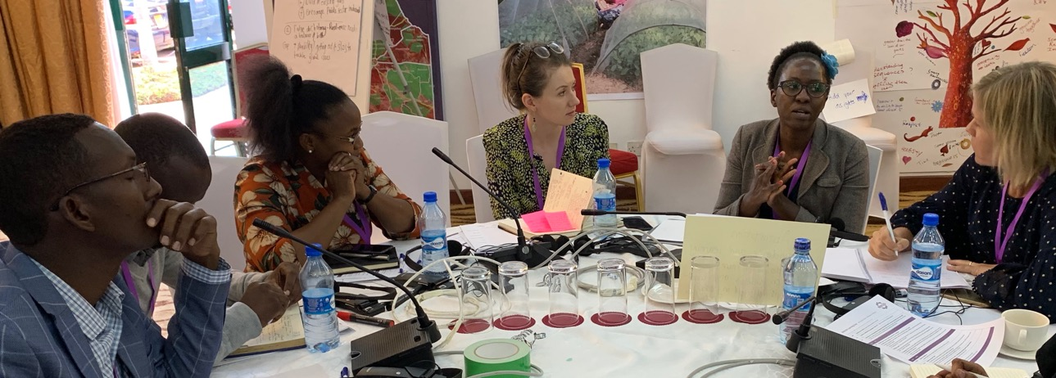
Collaborating with partners in a consortium

Slide 2
This presentation: 1. Advantages and challenges of working in consortia 2. Examples and learnings 3. Six principles: things to keep in mind when setting up consortia
Notes:
This presentation will show the advantages and challenges of working in consortia. It will provide examples and learnings of what is important to keep in mind when setting up a consortia on climate resilience.

Slide 3
Consortia: different ways of working with partners
Making Local Resilience Count
One Billion Coalition for Resilience
Bringing together different types of knowledge and expertise
Understanding the complexity of the system
Co-producing new insights and strategies for action
Reaching scale
Notes:
Working in consortia is often a requirement to access funding for adaptation and resilience work. The idea is that by bringing diverse partners to the table, we are better able to integrate different perspectives and different types of expert knowledge.
Working in partnership like this, brings the opportunity to truly engage as partners, appreciating expert knowledge brought to the table. If we manage to work in a true partnership, appreciating all types of knowledge, we are able to co-produced new insights that will allow us to better plan and monitor strategies for action.
There are multiple examples of consortia work with regard to climate action, such as here on the slide are 1BC, BRACED and PfR.
However, working in partnership like this needs careful planning and management. In this presentation we will share some thoughts about what is important to plan for and work effectively in consortia.

Slide 4
Working in consortia
Advantages
Challenges
Joint vision and goals between partners
Diverse types of knowledge
Co-produced strategies
More integrated systems thinking
Broader reach
Communication across diverse organisations can be challenging
Co-ordination between partners takes time and requires resources
Finding effective ways for trans-disciplinary learning
Notes:
Linking learning and practice in a consortium is a continuous process that often integrates past learning from other processes whilst envisaging the consortium’s contribution far beyond the project timeframe.
The ongoing work of communities of practice on certain aspects of climate change adaptation contribute to a body of knowledge that surpasses single programme/ project results and embraces all existing aspects from theory and practice.
A consortium should have ongoing engagement with the wider discourse around the issues we focus upon in order to meaningfully contribute to a larger community of practice.

Slide 5
What is co-production?
The process of sharing learning and producing new knowledge:
This could include partners from different academic disciplines, or representatives of different types of organisations or sectors.
The learning process values all perspectives and the endeavour is to jointly formulate new knowledge.
Notes:
The term co-production has been interpreted in many different ways. In the context of this presentation, we use the term to describe the process of sharing learning and producing new knowledge, while engaging with diverse groups of knowledge holders.
Embracing complexity has been recognized as an important basis for addressing the challenges of our time, including especially the rising climate risks.
Working in large and diverse teams can help to advance understanding of systemic challenges, mobilise different types of knowledge, create synergies and develop appropriate responses.
However, working in partnership with a diversity of stakeholders and across disciplines, can be challenging. Co-production of knowledge is a complex process and can often be frustrating to the partners, especially when they have to bridge different perspectives, values, types of knowledge, and ways of working.
To overcome these challenges and effectively learn together partners should feel ownership of the process and its outcomes.

Slide 6
Concept note & proposal development
Implementation phase
(incl. wrap up)
Inception phase
LS
Notes:
When working in consortia we need to understand that there are several phases of working in consortia. Often partnerships are only considered in the implementation phase – and this can lead to conflict and lack of trust in the partnership.
In the following we will explore what to focus on in the following stages:
Concept and proposal development stage
Inception phase
Implementation phase and wrap up

Slide 7
Concept note & proposal development
Inception phase
Implementation phase
(incl. wrap up)
Vision, goals, etc.
Choice of partners
Clearing expectations
Modality of collaboration
Budget allocation
Confirm vision, impact, expectations
Build trust & ownership
Addressing power issues
Working modalities
Managing consortia priorities & demands
Accommodating different ambitions
Supporting innovation
Valuing, maintaining connection & motivation
Incentives
Learning & adaptive management
Leadership
LS
Notes:
Each one of these stages have important considerations and it is important to be aware of these to move smoothly to the implementation phase.
In the beginning stages, it is especially important that a clear vision and goals are established by all partners. This should ideally result in additional partners being invited to support the vision. Clear expectations, explicit ways of working and transparent budget allocation are also important in the first phase.
In the inception phase it is important that the vision and goal are confirmed, and that trust and ownership of the process are actively fostered between all partners. This is also when working modalities should be clarified and any power issues within the team should be addressed.
During implementation it is important to maintain a good working relationship between all partners by managing priorities and demands, accommodating different ambitions and supporting innovation in the process.
All processes require active learning (and processes to allow this to happen!), benevolent and strategic leadership and some incentives for the partners to fully engage.

Slide 8
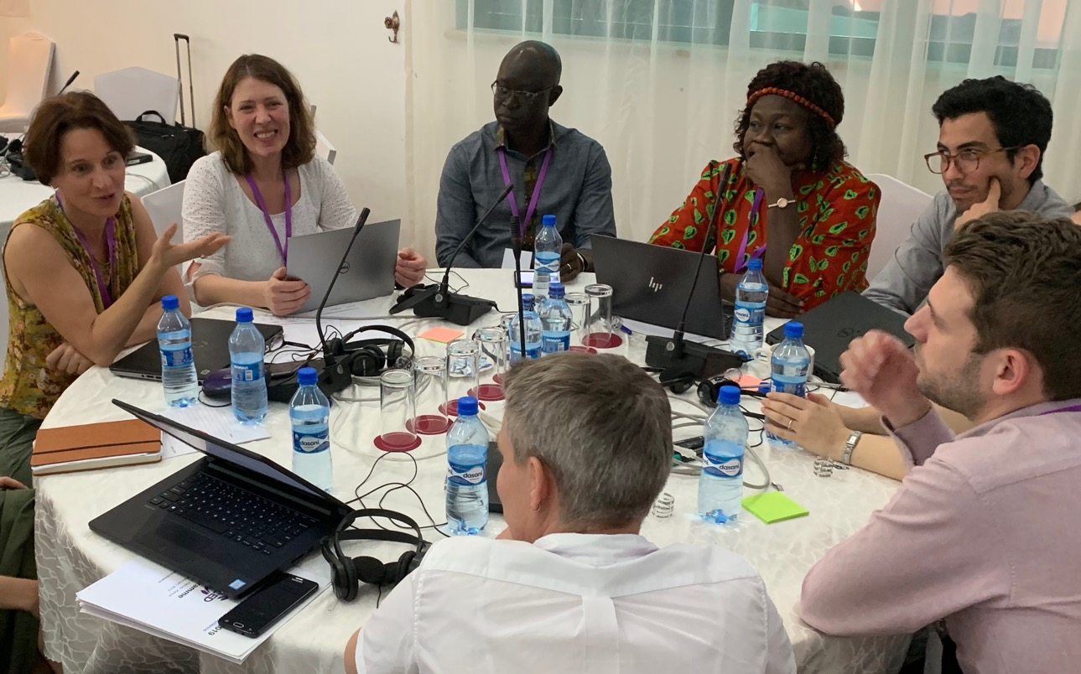
Principle 1: Building on existing efforts
LR
Notes:
What are key challenges?
Often funders feel pressured to look for a new approach, idea or focus area, and show less appreciation for supporting or building on ongoing existing processes notwithstanding their value and potential contribution to achieving the goals of the call.
Similarly, calls for proposals (and responses by project proposal developers) sometimes appear to exist in a vacuum, not considering parallel work supported by other funders, existing initiatives that one could build on, or the development context and priorities as determined by national and/or global policy processes, and local contexts and realities.
Possible action
The definition of a clear thematic focus for the call for proposals is critical, as this is the point of departure which will likely determine the scope and emphasis of the consortium. While extensive research on ongoing local, regional or global adaptation and development processes by funders (and project proposal developers alike) can be time consuming, this will allow a closer alignment of a programme with existing initiatives. This would allow new proposals to more effectively contribute to currently implemented strategies and support local, national or regional development pathways more effectively and sustainably, supporting a deeper understanding of complex systemic change.
Consultative processes and dialogue between funders and relevant stakeholders (including prospective project proposal developers) during the development of the call for proposals around the thematic focus and scope of a call can strengthen programme relevance, local ownership and thus effectiveness of interventions.
Calls for proposals should require the inclusion of a section on how the proposed initiative builds on past initiatives, avoids replication or redundancy, and responds to local and national development priorities.
The proposal development process should explore different types of knowledge (including traditional knowledge) and support their inclusion/ consideration in the proposal development process.

Slide 9
Test yourself...
Checklist
Has the thematic focus of the call for proposals been identified in a consultative manner, building on past initiatives and considering national development pathways?
Does the call for proposals require the recognition and integration of existing research/ developmental efforts in the field?
Does the call for proposals support and not undermine local or national development pathways?
Does the proposal effectively include diverse types of knowledge?

Slide 10
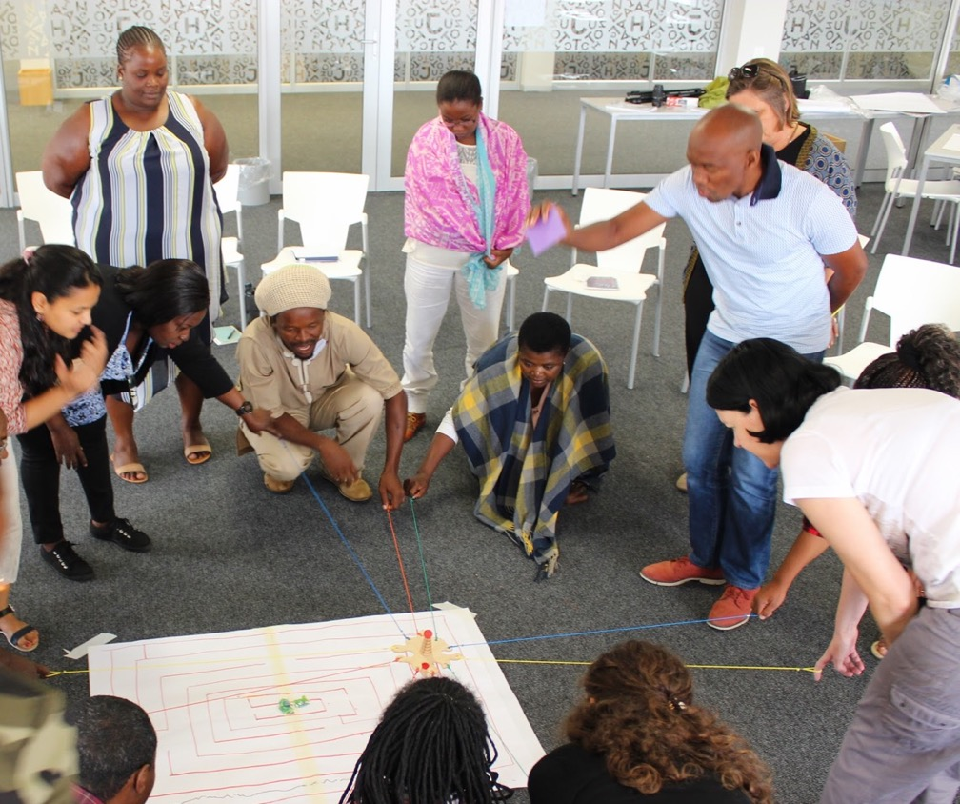
Principle 2: Being clear on desired impact
LS
Notes:
What are key challenges?
A programme’s desired impact should be the key determinant of its length and this will depend on whether its core focus is implementation, research or policy influence. Funders often expect outcomes and impact in all three areas, in increasingly short periods of time.
Funders are often naive about the time it takes for project activities and outcomes to become integrated into ongoing processes which support national, regional or global development pathways; and do not sufficiently value the resulting benefits that could arise from a single project making a sustained contribution towards processes of transformative change.
Balancing flexibility in the call for proposals with sufficient uniformity in the programming approach to facilitate cross-programme learning can be difficult, especially if the funder seeks to achieve a specific impact.
Achieving impact often requires the ability to be flexible and responsive to windows of opportunity, which can conflict with rigid budgeting, implementing or reporting systems (e.g. tied to strict M&E systems and log frames, where outcomes are predetermined and need to be closely adhered to).
Funders need to be aware that reporting on impact in policy and practice is difficult and this should be taken into account in the requirements around rigid M&E systems. This is due to the finite lifespan of a programme/ project, which means that many of the more impactful results may only be achieved once the project ends, and the challenges around the issue of attribution versus contribution.
Research-focused consortia may face challenges when seeking to implement research for impact programmes, unless a strong element of co-design and knowledge co-production is included, and consortia partners extend beyond the academic realm.
Possible action
Calls for proposals need to be clear and realistic about the desired impact they seek project proposal developers to achieve, and funders should determine the length of the programme accordingly. In cases of research for impact programmes, sufficient time needs to be allowed to produce high quality research and research uptake in policy and practice. Feedback from various partners highlighted an ideal minimum of four years. That being said, project proposal developers need to think about and work towards impact throughout the project and not just once results have been produced (i.e. likely to be very close to the end of the project). Similarly, implementation- and policy-focused projects should count with five and eight years respectively as a minimum threshold to result in sustainable and significant impact.
In order to achieve longer-lasting contribution, projects need time to actively engage and consult with the wider community of practice and affected local stakeholders, share results as they emerge and take on new lessons learnt from elsewhere.
Calls need to encourage consortia to include partners that are likely to contribute to the achievement of impact (e.g. practitioners, policy and government partners), and the use of approaches, methods and tools (e.g. co-design, co-production, experiential learning) that are likely to lead to uptake of project findings.
Funders and project proposal developers need to have clarity over their broad desired results and impact but ideally there should be a degree of flexibility on how the results can be achieved and how responsive implementers can be to windows of opportunity. This is closely tied to issues of adaptive management and the design of M&E and learning systems. In addition, maintaining open lines of communication and building a relationship of trust between funders and project implementers is critical in this respect.

Slide 11
Test yourself...
Checklist
What are the requirements for how the M&E system is set up and the extent to which outcomes are predetermined, or allow for indicators and monitoring plans to evolve with the project?
To which extent is adaptive programming and learning encouraged (including in the allocation of budget)?
What mechanisms can be put in place to track impact beyond the life of the project?
How do strict requirements around programme thematic or geographical scope, or team composition, curtail or enhance opportunities for impact?
Notes:
though there is no blueprint (depends on individuals, orgs, size, etc.) we developed some guidance on what is useful to consider as you are planning to work in a consortium

Slide 12
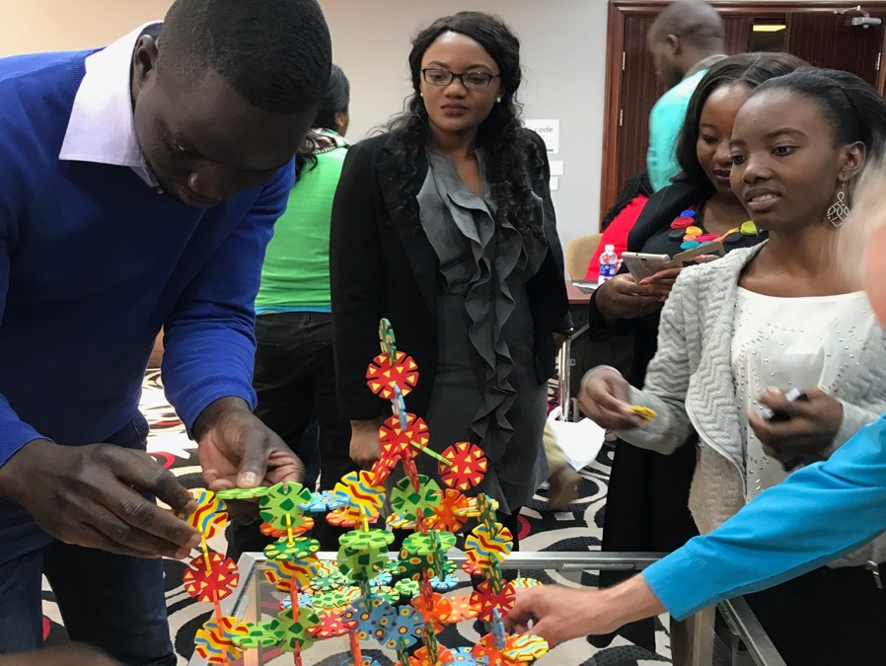
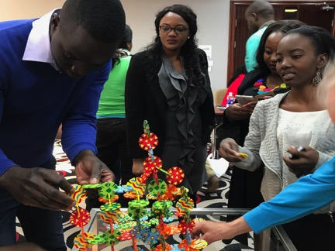
Principle 3: Early discussions on joint vision, expectations and clear responsibilities are the basis for effective cross-cultural and transdisciplinary engagement
Notes:
What are key challenges?
Proposal writing processes are often unfunded and confined to tight timeframes. Consequently, many organisations are not in the position to contribute adequate resources (time, funds, “mental space”) to participate effectively in proposal development processes (e.g. to meet face-to-face to plan activities, etc.) and therefore this relies on the expertise and capacity of the initiating partner organisations.
The process of designing and forming a consortium generally takes place in the context of uncertainty as to whether the proposal will actually be successful. This means that proposals are often put together under pressure, by a limited set of partners (or individuals) who can set time aside, without paying adequate attention to a number of critical elements that will lay a solid base for the development and implementation of a programme/project (see below).
A highly competitive process can place a burden on participating organisations, as some partners are competing with organisations within the same community of practice and therefore possibly undermining current or future collaboration within a certain thematic field.
The range of partners that project proposal developers select is often determined by the call for proposals. At times, this means that new partners are included without being clear about how they will collaborate effectively. Barriers between individuals from different cultural, disciplinary or language background might lead to the establishment of dysfunctional consortia if inadequate attention is paid to creating the pre-conditions for collaboration from an early stage.
Possible action
Under these circumstances, the composition of a consortium team and drafting of the initial proposal is a delicate process, which requires paying attention and jointly discussing and deciding on - among as many of the consortium partners as possible, ideally in a face-to-face setting - a number of factors.
The development of a joint vision and formulation of key objectives should be soundly rooted in ongoing processes/practice and ideally be supported by a consultative process with the community of practice or project beneficiaries. The formulation of a theory of change can support teams to agree on their vision and underpinning strategic principles, assumptions and activities, and will support the project implementation process. While this step might be time consuming and challenging, it is an important prerequisite to effective working and learning in consortia. If the common vision is not ensured at the proposal writing stage, the consortium will have to return to this in the inception phase and might have to repeat the planning process to ensure all partners are on board.
Clarity on expectations: It is critical to explore and discuss different partners’ expectations as early as possible, including around what partners would like to achieve (e.g. around desired impact), how they would expect and like the consortium to work, what they are prepared to commit to, what skills they bring to the partnership and what goes beyond their organisational niche, budgetary issues, etc. In addition, it’s a sound idea to discuss clearly as a group what being part of a consortium implies (e.g. commitment to working collaboratively and comparatively, the difference between working in single disciplinary teams versus multidisciplinary consortia) and the amount of additional time that partners will need to dedicate to the coordination and administrative aspects of the project.
It is key to define activities and a timeline, which should include learning activities, monitoring and evaluation elements, reporting requirements, knowledge management and engagement with the wider community of practice. Similarly, allocation of roles and responsibilities within the consortium, based on the range of skills, expectations and interests that different partners bring to the table, is a key step that needs to be discussed in the proposal development phase. Often, depending on the call for proposals, this detailed planning process can take place once the proposal has been awarded or as part of a proposal development grant (after approval of the concept note).
In the proposal development stage, partners should hold the first round of discussions around the modality of collaboration (including ways of agreeing on project topic, focus, size, contents, roles) and consortium governance structure (including mechanisms designed to deal with internal conflict and tensions). Developing a governance structure prior to implementation can help avoid misunderstandings and frustration within the consortium team later on. This can then be reviewed from time to time and adjusted as part of the adaptive programming cycle of the consortium.
A critical aspect in proposal development, which is often a source of tension between partners, is the negotiation around budgets. It is important that the lead organisation facilitates the budget discussion with all partners in a collegial and transparent manner, while ensuring that the resultant budget is realistic. Depending on the organisational structure, the project lead is often the budget holder, and therefore is responsible for effective project delivery of the overall consortium (depending on the its financial model). This can lead to tensions with other consortium partners, and it is important that these are resolved during the budget negotiations so as to ensure that the consortium members are clear of their roles and responsibilities, have a good understanding of the actual processes and feel able to implement their contribution within the available budget.
Key issues to consider in the allocation of different budget lines, is ensuring sufficient funds are kept for face-to-face meetings (critical for initial relationship building and making progress in the work), and for M&E, knowledge management and learning. It is also important to think about the proportion of full-time versus part-time staff to be included, as creating a large consortium with many people with a small proportion of time (e.g. less than 10%) allocated to the project often just adds to administrative and coordination burdens, while bringing little added value. The issue of sub-contracts with local partners (in the case of decentralised or mixed budget methods) should also be discussed openly, clarifying a range of expectations, from power issues to financial reporting. If the donor allows, a degree of flexibility in the budget should be maintained for responding to unexpected opportunities (e.g. tied to impact), to support synthesis, and allow adaptive programming to be implemented effectively.

Slide 13
Test yourself...
Checklist
Has face-to-face time (including explicit team building activities) been adequately budgeted for, especially during the inception phase, to build trust and team cohesion?
Do partners feel ownership of consortium vision, processes and results?
Have joint values that will underlie the implementation of the project been jointly developed?
Are mechanisms for reflection and surfacing tensions or conflict in place?
Is the team able to resolve conflicts and learn from this process?
Do all partners feel they are considered in the governance and implementation of the project?

Slide 14
Principle 4: Building trust and strong relationships is key to unlocking effective transdisciplinary collaboration
Notes:
What are key challenges?
Consortia often include many new partners that have not worked together before, coming from a range of different disciplines, cultures, geographies and institutional mandates, making collaboration tricky, unless the building of trust is specifically invested in.
Relationship building is often overlooked and taken for granted, as focus is often exclusively placed on deliverables and achieving project goals and objectives.
Large-scale transdisciplinary collaborations often comprise of partners that are geographically dispersed and span a number of countries and time-zones. Insensitive handling of this issue can undermine effective collaboration in teams.
Unresolved conflict within teams can lead to the undermining of trust, weakened relationships and poor collaboration, ultimately resulting in less effective results and impact.
Possible action
During the inception phase of a project, it is important to start with confirming the vision, the desired impact, partners’ expectations and activities and processes for the coming years. As these discussions will invariably have linkages to the planning of budgets and time allocations, the beginning of a learning journey should ensure the establishment of sound partnership relations alongside the planning process.
Establishing a sound team, based on trust, ownership and team cohesion, is one of the most important investments that one can make at the beginning of a project, particularly if new partners that have not worked together before are involved.
The importance of face-to-face meetings has been acknowledged by many teams, and while often expensive and logistically challenging, it is an important investment to ensure sound working within the team.
At this stage, it is also advisable to co-develop the values upon which the collaboration between partners is built, e.g. respect for contributions, appreciation of differing perspectives, transparency within the team, etc. If these have been well-articulated they will not only provide a sound basis for collaboration, but will also facilitate processes of self-correction when tensions or conflicts arise. Subsequently, regular check-ins, maintenance and processes that support internal learning and reflection are critical for effectively working together, to achieve transdisciplinary learning and to draw on the diversity of knowledge of all project partners.
Building relationships and trust in a new team can be supported by the design of interactive and experiential learning processes at regular intervals. Designing these processes with the consortia members (or at least a delegated smaller team of partners) will strengthen ownership of these learning processes and allow for a vibrant design that addresses the learning agenda and focuses on project deliverables and contents.

Slide 15
Test yourself...
Checklist
Has face-to-face time been adequately budgeted for, especially during the inception phase, to build trust and team cohesion?
Do partners feel ownership of consortium vision, processes and results?
Have joint values that will underlie the implementation of the project been jointly developed?
Are mechanisms for reflection and surfacing tensions or conflict in place?
Is the team able to resolve conflicts and learn from this process?
Do all partners feel they are considered in the governance and implementation of the project?

Slide 16
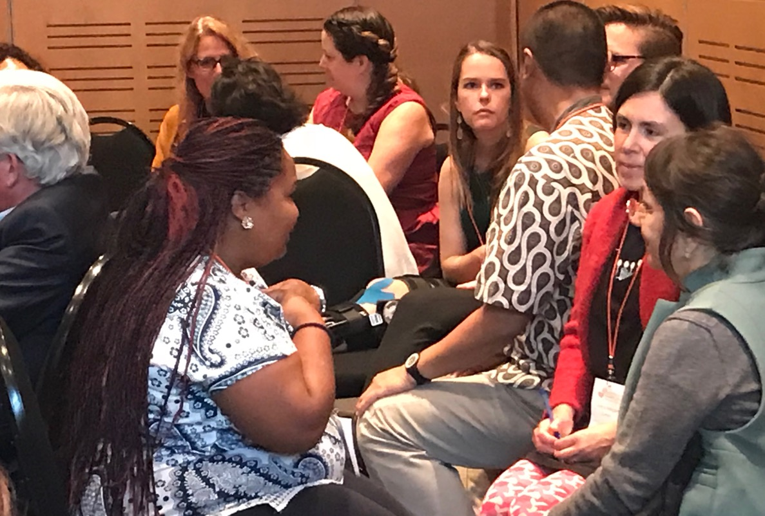
Principle 5: Addressing diversity in the consortium by establishing a shared and transparent governance structure
Notes:
What are key challenges?
Large consortia comprise diverse teams that invariably bring together diverse personalities and styles of communicating, engaging and working. This poses challenges as it may lead to tensions and conflict, as well as delays tied to differences in style and the efforts required to address these. Jointly discussing and agreeing to a governance system that guides how the consortium works together is thus critical.
If the governance systems are not understood and embraced by all members of a consortium, internal tensions, distrust and conflict may arise. Governance principles sometimes only reflect the values and mechanisms that the lead organisation(s) or funder deem appropriate, and which are imposed on all partners within the consortium in a top down manner.
Collaboration can be undermined by rigid and inflexible governance or budget structures.
Time zones, language preferences, varying access to virtual communication (including issues around internet speed, power stability, etc.) and issues of accessibility (e.g. transport, ability to obtain a visa for reaching a joint team meeting) can severely limit participation of certain partners. Often the lead organisation’s or funder’s assumptions and expectations may not necessarily hold in the context of less resourced partners or areas with less developed technical or organisational infrastructure.
Possible action
Agreeing on the internal governance system and principles of collaboration in a transparent, collaborative way is critical to establish a shared modality of working together synergistically. It is important to discuss how decision making will be undertaken, responsibilities shared, accountability and transparency ensured, processes of reflection and learning integrated, etc. While it is important that all partners have ownership of the overall process, and are clear about their level and way of engagement, the degree of formalisation of such agreements (e.g. through a written partnership agreement, an MoU, verbal agreement) is up to individual consortia.
Working styles and cultures: While creating an environment in the team that appreciates this diversity and surfaces and supports these different styles is important, one should also not be naive about the additional time and effort such dedicated processes require. This should therefore be a consideration when it comes to deciding and committing on a project’s deliverables, as levels of ambition need to be realistic and correlated to the constraints imposed by the partnership. At the same time, it may be necessary to discuss minimum requirements and standards for effective collaboration (e.g. relating to response timeframes, delivery of cross-partner outputs, rules around authorship), which can be formalised in a partnership agreement.
Geographical disparities: It is critical to consider the limitations posed by different time zones, languages, varying access to virtual communication and issues of accessibility when planning for effective collaboration. It is advisable to openly discuss the power differentials that arise as a result of geographical factors (e.g. north-south, English- versus French-speaking partners) and to address these specifically, e.g. by providing additional support to certain partner. Once again, such considerations are important when committing to certain deliverables and processes, to ensure the project is being realistic with respect to what can be achieved by its partners.
Conflict management: When working in consortia, it is important to establish mechanisms for surfacing and managing tensions and conflict in the team as early as possible, such as through integrating reflection processes and implementing regular health-checks that will allow consortium members to express any frustrations they may have. If conflicts are not addressed they can seriously hamper the ability of a consortium to work effectively, and to create synergies between different types of knowledge. These processes provide an excellent opportunity for learning from crises, conflict and failure – addressing the challenges in innovative and effective ways - and for adaptive management.
In the course of the lifetime of the consortium, it is important to regularly reflect on these principles and processes of collaboration and to jointly tweak and adjust them as needed.

Slide 17
Test yourself...
Checklist
Are governance structures clear and transparent, and understood by all partners?
Are the constraints imposed by different working styles and geographical disparities adequately addressed (to the extent they can be) and accounted for?
Can project members address tensions or conflict within the consortium effectively?
Are crises and conflict recognised as opportunities to improve learning and organizational structure or consortium performance?

Slide 18
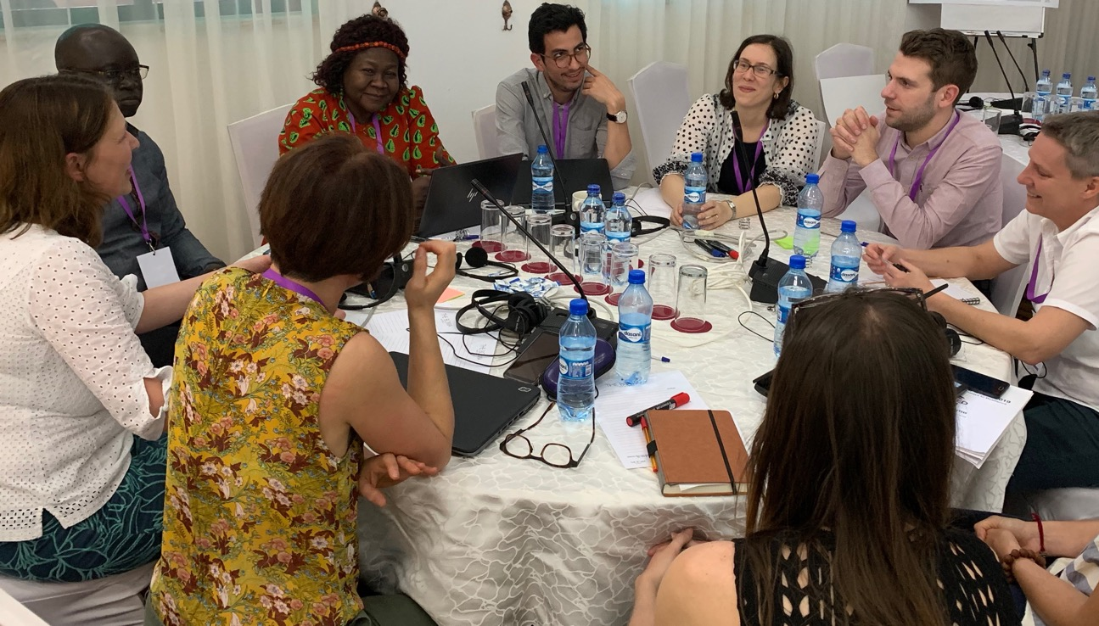
Principle 6: Create and implement appropriate mechanisms for reflection, learning and course correction
Notes:
Promoting reflection and learning in transdisciplinary teams requires careful consideration. Project teams should consider carefully how they would best like to work in teams and facilitate learning within their consortium, and it is important to allow enough budget to accommodate these processes. Collaboration in diverse teams can be more time consuming than working with a single narrow focus. Maintaining sound working relationships within the consortium is crucial, and it is important to think about mechanisms that will allow the team to bring tensions or frustrations to the surface at an early stage, so that these can be effectively addressed by the team and active learning for all partners can be promoted. Building and caring for this trust and cohesion within the consortium will be the foundation of the ongoing collaboration and thus requires both a sound point of departure and regular maintenance.
Once the proposal is awarded, it is important that the consortium actively manages interactions and engagements between all internal and external stakeholders. This process should be founded on the agreed transparent governance principles, and should actively promote learning and reflection cycles within the consortium – across disciplines and thematic themes. If necessary the ways of working within a consortium should be reviewed and adapted to allow more effective learning and ultimately implementation. It is crucial that conflicts within the consortium are addressed constructively and early on – to ensure learning can improve further planning and implementation.
What are key challenges?
Learning from failure is not always seen as a strength, but as a project weakness. This can prevent important lessons from surfacing and early course corrections from taking place.
Power struggles around influence and budgets can undermine effective reflection and learning in consortia.
Dealing with internal conflict can be challenging
Hidden agendas
Possible action
Plan for and implement regular reflection sessions that will allow consortium members to express any frustrations they may have, to bring to the surface existing conflict and tensions.
Plan and implement processes that will allow effective learning from crises, conflict and failure – addressing the challenges in innovative and effective ways.
Ensure that the learning is documented and can influence adaptive programming.

Slide 19
Test yourself...
Checklist
Are project teams effectively reflecting on their process and practice?
Have you explored different processes of reflection appropriate to different groups?
Is project implementation periodically reviewed in the light of the learning within the team?
Is the learning journey of the team documented and reflected upon at regular intervals?

Slide 20
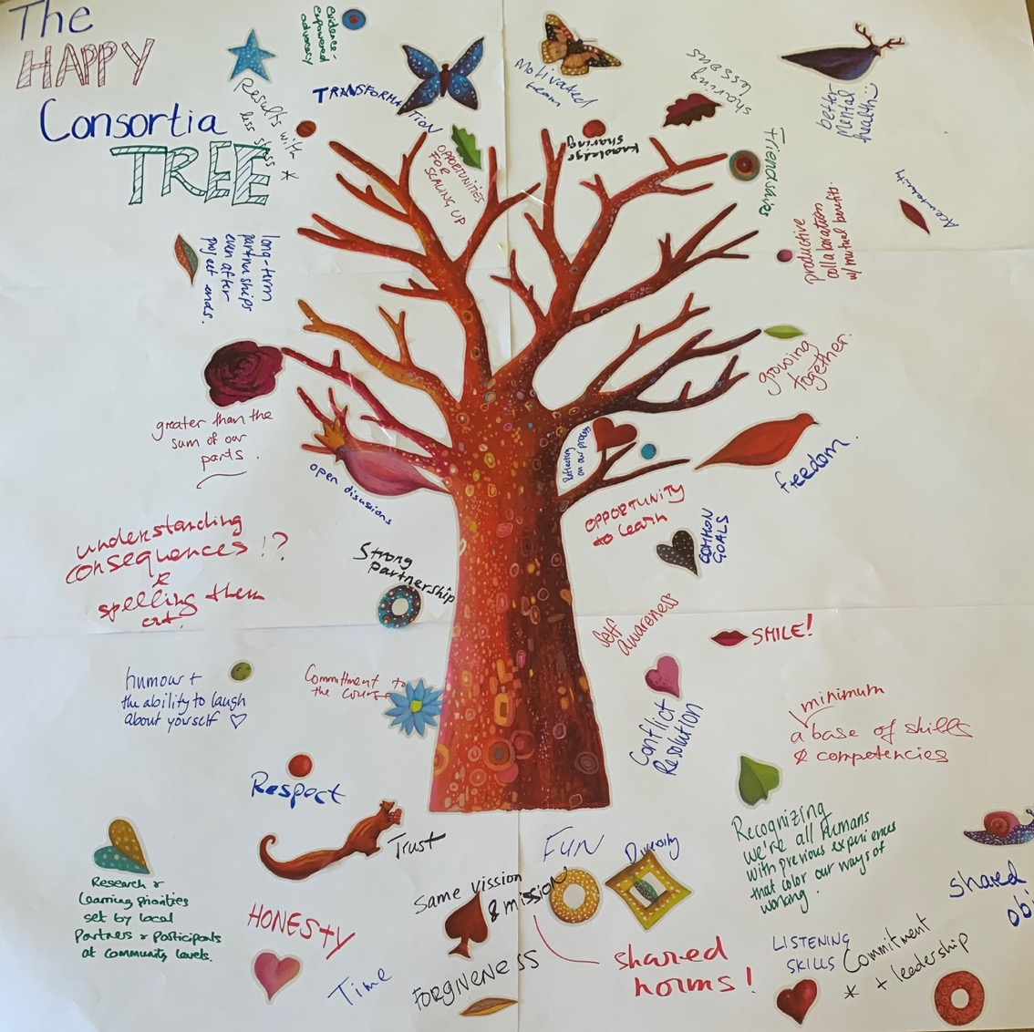
Working in consortia tree as brainstormed at the BRACED Annual Learning Event 2019
Notes:
The legacy of a project is often two-fold and it is important to appreciate both aspects when doing the final stocktake and reflection within the consortium.
On the one hand, the project has delivered some activities and processes and shared the results and lessons learnt on the specific areas with one or more communities of practice. This contribution can support the overall development of a specific field or process.
But on the other hand, team members have benefited from capacity development in the course of the project - through effective learning and reflection processes, innovative approaches to transdisciplinary learning and working across disciplines and with a wide range of stakeholders. If this has been effective it may be the more profound contribution towards the existing capacity to address complex problems. These skills and capacities are not limited to a specific field and are often versatile in its use.

